Slide 1

SMILE SELFIE CAPTURE
Ashna Yasin, S3 MCA
Guided by: Dr. Fousia M Shamsudeen

Slide 2
TABLE OF CONTENTS
Introduction
Problem statement
Literature review
Gaps Identified
Proposed plan
Methodology
Block diagram
Screenshots
Future enhancements

Slide 3
INTRODUCTION
In today’s selfie-driven culture, traditional methods which require manual input often miss genuine smiles or create awkward poses. This project utilizes OpenCV and Haar Cascade classifiers to continuously monitor facial expressions in real-time, and automatically capture images when a smile is detected, allowing genuine emotions to be captured on camera.

Slide 4
PROBLEM STATEMENT
This project aims to design an innovative, interactive system using OpenCV to enhance user engagement by developing a hands-free way to take selfies. By automating image capture through real-time smile detection, the system provides a seamless, efficient, and enjoyable user experience that captures genuine moments effortlessly.

Slide 5
LITERATURE REVIEW
Title | Author | Published | Source
Self-Portraits Taken Automatically by Detecting Smiles | R. Regin, S. Sai Vishaal, S. Vishal, Shyam Bakkiyaraj, S. Suman Rajest. | 2024 | Information Horizons: AMERICAN Journal of Library and Information Science Innovation
Review on Smile Detection | Anurag Goswami, Ganjigunta Ramakrishna, Dr. Rajni Sethi | 2021 | International Journal of Scientific Research in Computer Science, Engineering and Information Technology

Slide 6
GAPS IDENTIFIED
Limited to visual feedback only, lacking auditory confirmation.
No customization options for captured images.
Prone to false positives due to simple smile detection with no cooldown feature.

Slide 7
PROPOSED PLAN
Implement auditory feedback to confirm smile detection and image saving.
Introduce customization options for captured images, including the ability to apply various filters.
Reduce false positives by adding a cooldown period between selfie captures.

Slide 8
METHODOLOGY
Filter Application & Image Saving
Filters are applied on the images depending on user’s input and then it is automatically saved to the device.
Real-Time Video Feed
A live video feed is displayed, showing the user’s face with rectangles drawn around the detected regions
05
01
04
Voice Feedback
The system provides voice feedback upon detecting a smile and after an image is saved, informing the user of the actions take
Smile & Face Detection
The project uses OpenCV’s CascadeClassifier to detect both faces and smiles in real-time using Haar Cascades
02
03
Image Capture
The system captures an image when smile is detected, and also implements cooldown period to prevent multiple captures.

Slide 9
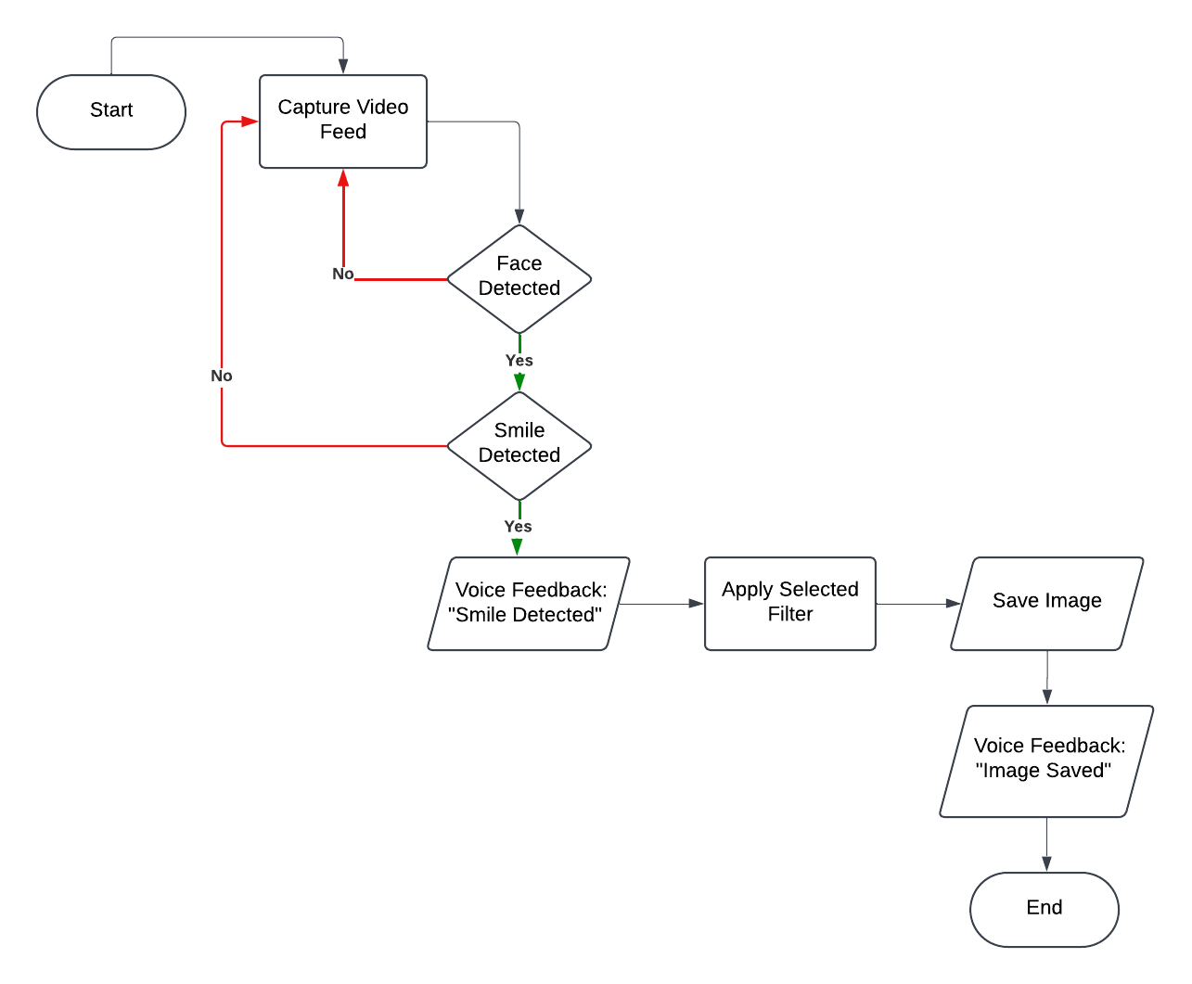
BLOCK DIAGRAM

Slide 10


SCREENSHOTS
NO FILTER
GRAYSCALE FILTER

Slide 11


SEPIA FILTER
BLUR FILTER

Slide 12
FUTURE ENHANCEMENTS
Mobile App Conversion: Transform the project into a mobile application for easier accessibility and a seamless, on-the-go experience.
Multi-Face Detection and Group Selfies: Implement multi-face detection to support group selfies, capturing when all or a majority of the group members are smiling.
Support for Additional Expressions: Extend detection to other facial expressions, like surprise or happiness, broadening the app's capabilities.

Slide 13
THANK YOU

